Slide 1

Dz-Emotion: An Algerian Dialect Dataset for Text Based Emotion Detection
The Second Edition of the International Conference on Recent Advances in Mathematics and Informatics (ICRAMI'2025)
20-23 November 2025 Sousse (Tunisia)
Houdna Khilouf, Amel Ziani, Nada Ahmed Malek, Didier Schwab, Mohamed Amine Yakoubi
Houdna Khilouf
Ph.D in Data Science
LIMA Laboratory
Chadli Bendjedid University El Tarf, Algeria
h.khilouf@univ-eltarf.dz

Slide 2

Outline
Introduction
Proposed solution
Problem
statement
Results
Conclusion & Future works

Slide 3
Introduction
Introduction
Emotion is a complex psychological and physiological response that reflects how humans feel in different situations.
A
Emotions are an important part of our daily life. They affect how we think, communicate, and interact with others
B
Emotion detection and analysis have been widely researched, with applications in diverse fields such as psychology, behavioral sciences, computer science, ........,
C

Slide 4




Main emotion modalities

Slide 5
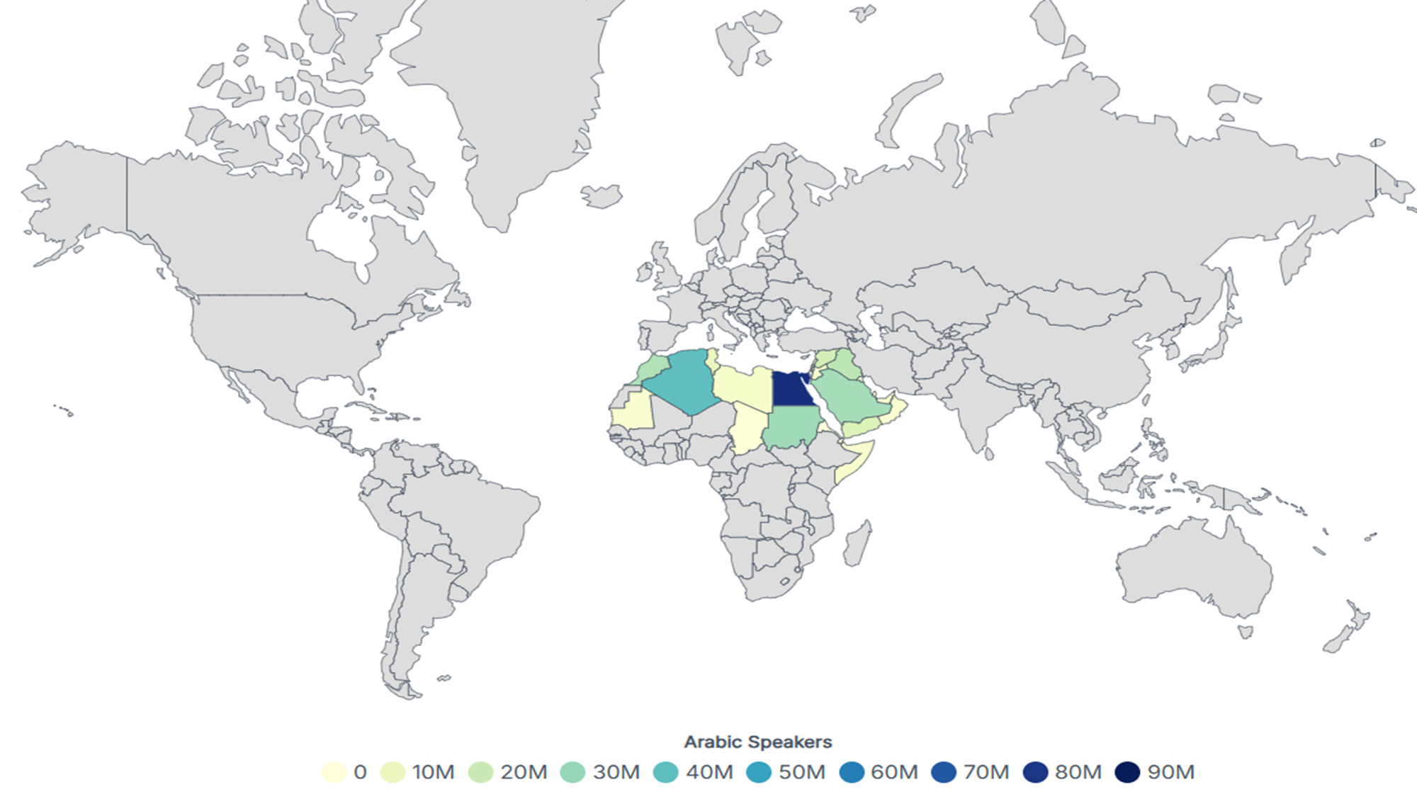
Arabic Speaking Countries 2025
worldpopulationreview.com

Slide 6
Challenges of Arabic Language
First, Arabic is not a single, uniform language. While Modern Standard Arabic (MSA) is used in news, government, and education, everyday conversations take place in dialects Each dialect has its own vocabulary, grammar and even different spellings for the same word. A model trained without attention to this diversity can easily take the wrong meaning of what a user is asking.
Second, Cultural and contextual understanding is very important. Models trained only in English often miss the real meaning of Arabic expressions. For example, the phrase “يد واحدة لا تصفق” (one hand cannot clap) actually means “teamwork is essential.” Without Arabic-specific training, AI may translate incorrectly.

Slide 7
Challenges of Arabic Language
Third, Arabic is a root-based language where a single root can generate many words with different meanings depending on prefixes, suffixes. For example, the root ك-ت-ب (k-t-b) can produce kitab (book), maktab (office), katib (writer), and maktaba (library). For an AI model, this morphological richness makes tokenisation and meaning extraction much harder than in languages like English.

Slide 8
Arabic Language
-Algerian Dialect
Among the various Arabic dialects, the Algerian dialect (Darija) stands out as one of the most widely spoken in North Africa.
The Algerian dialect is characterized by its rich linguistic diversity. It blends elements from Classical Arabic, French, Berber (Tamazight), Turkish, and English, reflecting Algeria’s complex linguistic and multicultural context.
This linguistic fusion presents both opportunities and challenges in natural language processing (NLP), especially in emotion recognition, sentiment analysis, and machine translation.

Slide 9
Problem Statement
Recently, there has been significant interest in pre-training and fine-tuning large language models (LLMs) based on the transformer architecture, such as BERT, GPT, and their multilingual variants.
A
However, most of these models have been trained on high-resource languages
B
In contrast, Arabic dialects especially regional varieties like the Algerian dialect have less attention due to the scarcity of annotated datasets and the linguistic complexity of Arabic dialects.
C

Slide 10
Proposed Solution
Dataset Collection
Pre-trained models
Collect a label Dataset for text-based emotion detection with Arabic dialect Algerian
01
02
Choose Arabic pre-trained model Like DziriBERT;MARBERT;....
Fine-tuning
03
By adapts the large, pre-trained model to text emotion detection with dialect Algerian

Slide 11
Dz-Emotion
Fear
Anger
53%
29%
18%
YouTube
Instagram
FaceBook
1000
500
0
Disgust
Sadness
Surprise
Happiness

Slide 12
Dz-EmoBERT
Dz-Emotion
Algerian Arabic Dialect Dataset with 6,000 comments
01
Data pre-processing
Translation ,Normalization,remove urls , emoji, stop word,...
02
Arabic Pre-trained models
DziriBERT,MARBERT,ARBERT
03
Model configuration
Learning rate 2e-5 , number epochs 10 , Batch size 8
04

Slide 13
Results & Discussion
The results obtained after fine-tuning our dataset with different Arabic pre-trained model
DziriBERT 94.08%
Models | Accuracy | Precision | Rappel | F1-score
ARBERT | 86.00% | 85.95% | 86.00% | 85.93%
MARTBERT | 91.67% | 91.77% | 91.67% | 91.68%
DziriBERT | 94.08% | 94.07% | 94.08% | 94.07%
MARBERT 91.67%
ARBERT 86.00%
DziriBERT is the first Transformer-based language model that has been pre-trained specifically for the Algerian dialect.
MARBERT is a Transformer-based language model pre-trained on a massive collection of Arabic social media data, with a strong focus on dialectal Arabic
ARBERT is a Transformer-based language model pre-trained on Modern Standard Arabic (MSA) texts, designed to capture formal Arabic usage.

Slide 14
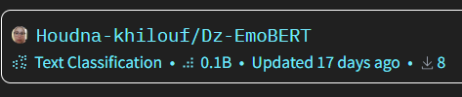
Conclusion
Public
01
Data & Model
02
Pravite

Slide 15
Future Work
we aim to develop a large Multimodal language model for emotion analysis that Contain all Algerian dialects, including Darija and Tamazight.

Slide 16

Houdna Khilouf
LIMA Laboratory
Ph.D. in Data Science
Chadli Bendjedid University El Tarf, Algeria
h.khilouf@univ-eltarf.dz

